Slide 1
Data Analysis Case
Occupational Hazards among Cocoa Farmers
By:
Rashid Ali

Slide 2
Introduction
Abstract
Research Questions
Analysis
Conclusion
Appendix

Slide 3
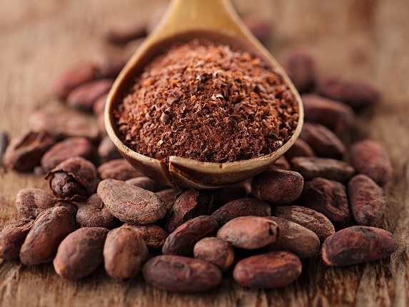
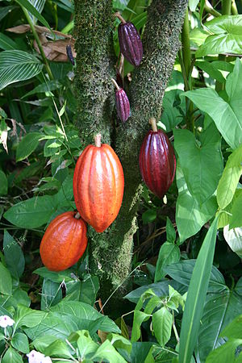

Introduction
Ghana is internationally recognized in the area of agriculture through the production of cocoa as one of its main foreign exchange earners and ranks second of the top five cocoa beans producing counties in the world
In Ghana, Cocoa is grown in six of the ten regions, and employs approximately 800,000 farm families
The government has developed a package known as cocoa “hi tech” with the view to exposing farmers to cocoa mass spraying exercise and soil fertility management practices to bring about increase in production and improve the livelihoods of cocoa farmers living in rural communities since 2003

Slide 4
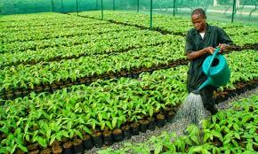
Introduction
Despite the enormous benefits generated from the cocoa mass spraying exercise, the chemicals used brought adverse effects on the health and safety of most cocoa farmers.
Also, due to the enormous use of agrochemicals during the mass spraying exercise, the environment, including these farmers, were frequently exposed to its risk effects

Slide 5
Abstract--Objectives
The general objective of this study was to investigate the health and safety among cocoa farmers in the Assin South District.
The specific objectives of this study are to:
identify the forms of hazards associated with the work of cocoa farmers.
examine the effects of these hazards on the health and safety of cocoa farmers.
explore the sources of information on occupational health and safety among cocoa farmers.
evaluate the health and safety practices employed by these cocoa farmers in the study area.
Notes:
Occupational hazard is described as a condition surrounding a work environment that increases the probability of death, illness or disability to a worker while hazard is defined as the inherent property of a substance or process that could cause injury or damage.

Slide 6
Abstract—Importance of the Study
assist in building a body of knowledge and adding new knowledge to the already existing limited information on occupational hazards that affect the health and safety of cocoa farmers and other farmers who engage in similar farm activities
help government and other policy makers as well as stakeholders to formulate appropriate policies and practices that would prevent cocoa farmers from suffering these work related diseases and injuries
provide some form of data from which further studies could be carried out to investigate the health and safety of cocoa farmers and other agricultural workers.

Slide 7
Research questions
The following research questions serve as a guide in achieving the objectives of the study:
What are the main forms of hazards associated with the work of cocoa farmers?
Where do these farmers get information on occupational health and safety practices?
What forms of health and safety practices are employed by these cocoa farmers?

Slide 8
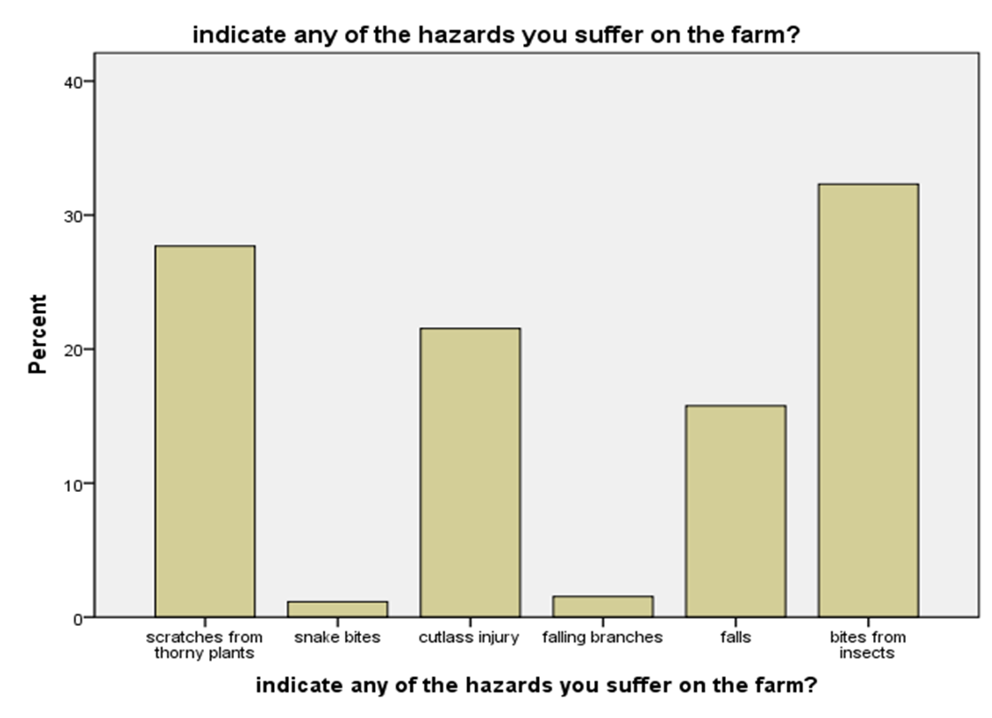
1. What are the main forms of hazards associated with the work of cocoa farmers ?
Research questions
Bites from insects
Scratches form thorny plants
Cutlass injury

Slide 9
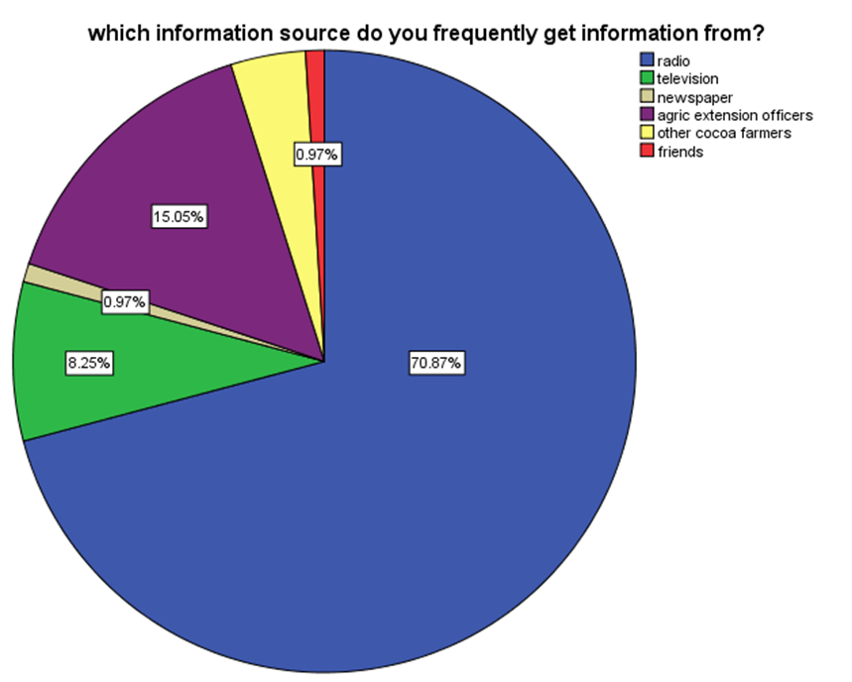
2. Where do these farmers get information on occupational health and safety practices
Research questions
Radio
Agric extension Officers
TV

Slide 10
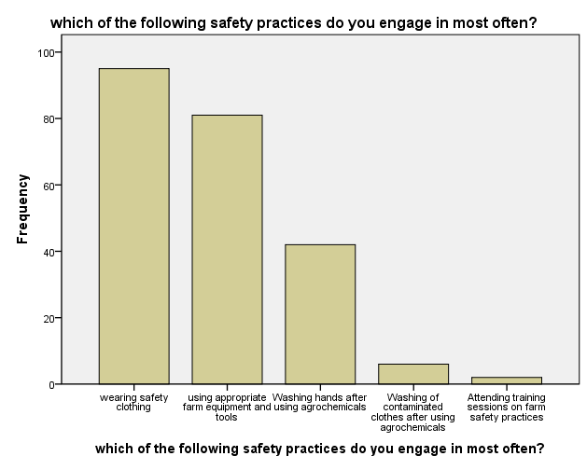
3. What forms of health and safety practices are employed by these cocoa farmers?
Research questions
Wearing safety clothing
using appropriate farm equipment and tools
Washing hands after using agrochemicals

Slide 11
Background characteristics | Frequency | Percentage
Analysis--1
* Sex
Male 152 58.5
Female 108 41.5
* Age
Less than 20 years 25 9.6
20-29 years 39 25.0
30-39 years 62 23.8
40-49 years 53 20.4
50 years and above 81 31.2
* Educational status
No education 50 19.2
Primary 39 15.0
Junior high 126 48.5
Senior high 26 10.0
Tertiary 19 7.3
* Marital status
Married 183 70.4
Never married 24 9.2
Divorced 24 9.2
Widowed 29 11.2
* No. of years engaged in cocoa farming
3-7 years 70 26.9
8-12 years 57 21.9
13- 17 years 29 11.
18-22 years 36 13.8
23 years and above 68 26.2
Characteristics of Respondents
58.5% of the respondents were males while 41.5% were females
31.2% of the respondents were 50 years and above while only 25 respondents representing 9.6 percent were within the ages of 20-29 years
almost half of the respondents had Junior High School education with only 19 respondents representing 7.3% having tertiary education
70.4% of the respondents were married
26.9% and 26.2% of them said they have been engaged in cocoa farming for 3-7 years and 23 years or more respectively
Total 260 100.0
Notes:
Aims to provide in-depth understanding of the people who participated in the study.
These background characteristics of respondents were of great interest to the study in ascertaining whether these variables pose different risk levels as respondents encounter accidents, injuries and diseases on their farms which could affect their health and safety.

Slide 12
Analysis--2
Hazards and Gender
Sex (%) Common hazard Male Female Total (N)
Chi-Square Tests
 | Value | df | Asymp. Sig. (2-sided)
Pearson Chi-Square | 15.427ª | 5 | .009
Likelihood Ratio | 15.416 | 5 | .009
Linear-by-Linear Association | .206 | 1 | .650
N of Valid Cases | 260
a. 4 cells (33.3%) have expected count less than 5. The minimum expected count is 1.25.
Scratches from thorny plants 52.9 47.1 100% (68)
Snake bites 75 25 100% (4)
Cutlass injury 67.2 32.8 100% (58)
Falling branches 75 25 100% (4)
Falls 34.1 65.9 100% (41)
Bites from insects 67.1 32.9 100% (85)
H0: There is no statistically significant relationship between sex of cocoa farmers and occupational hazards during cocoa production.
H1: There is statistically significant relationship between sex of cocoa farmers and occupational hazards during cocoa production.
Since P/sig=0.009, we reject H0 and accept H1
Notes:
Accidents happened more in men, except “falling”

Slide 13
Analysis--3
Age and Diseases
Chi-Square Tests
 | Value | df | Asymp. Sig. (2-sided)
Pearson Chi-Square | 33,076ª | 20 | ,033
Likelihood Ratio | 32,697 | 20 | ,036
Linear-by-Linear Association | 3,658 | 1 | ,056
N of Valid Cases | 243
a. 17 cells (56,7%) have expected count less than 5. The minimum expected count is ,41.
H0: There is no statistically significant relationship between Age of cocoa farmers and diseases do they suffer most often during cocoa production.
H1: There is statistically significant relationship between Age of cocoa farmers and diseases do they suffer most often during cocoa production.
Since P/sig=0.033, we reject H0 and accept H1

Slide 14
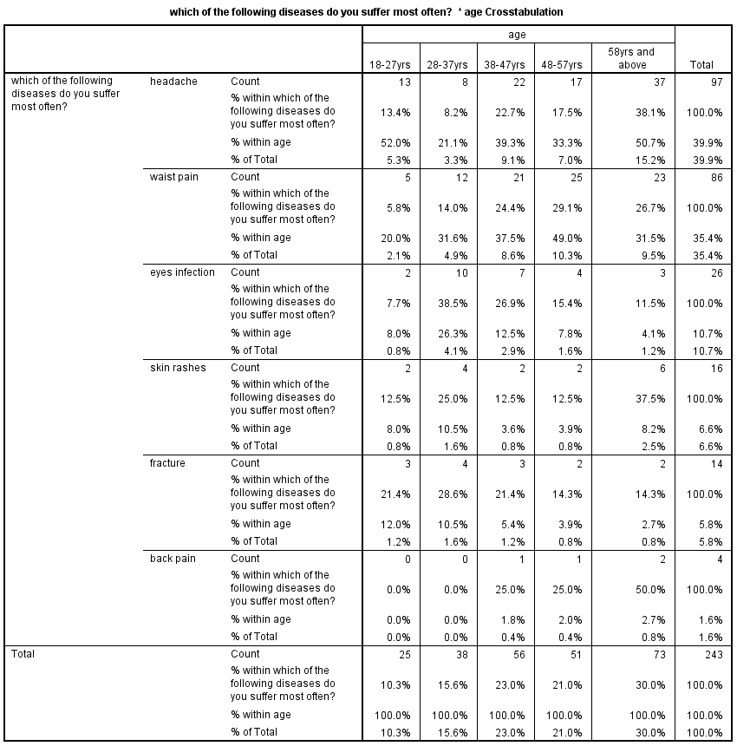

Slide 15
Analysis--4
Hazards and Years of Engagement
This finding indicates that cocoa farmers in the study area, depending on the length of time they have been engaged in farm operations, present different degrees of farm hazards associated with cocoa production in the study area.
The high incidence of scratches from thorns reported by cocoa farmers in the early years of production (3-7 years, 35.3%) could be as a result of the fact that at the early part of cocoa cultivation, farmers are inexperienced which predisposes them to frequent accidents and injuries.
The frequent occurrence of falling branches from cocoa and other trees on farmers who have been engaged in cocoa production for more than 23 years could be associated with frequent pruning of mature cocoa trees coupled with the degenerating health conditions of most cocoa farmers who are, supposedly, aged. Nevertheless, the non-reporting of falling branches among respondents in the early part of cocoa production may be explained by the fact that during the early years of cocoa production farmers are not engaged in pruning activities on the farm due to the fact that cocoa trees are not also tall enough to cause branches to fall.
These findings can be related to the system theory which identifies the farmer’s health characteristics as well as the work environment as components contributing to hazards, accidents and diseases.
Number of years engaged in cocoa farming (%) Common hazard 3-7 8-12 13-17 18-22 23+ Total (N)
Scratches from thorny plants 35.3 26.5 10.3 13.2 14.7 100 (68)
Snake bites 25.0 50.0 0.0 0.0 25.0 100(4)
Cutlass injury 15.5 13.8 17.2 20.7 37.8 100 (58)
Falling branches 0.0 25.0 0.0 25.0 50.0 100 (4)
Falls 19.5 26.8 12.2 4.9 36.6 100 (41)
Bites from insects 32.9 20.0 8.3 14.1 24.7 100 (85)

Slide 16
Analysis--5
Age Sex Yes No Total (N)
Male 78.9 21.1 100 (19)
Below 20 years Female 33.3 66.7 100 (6)
Sub-Total 68.0 32.0 100 (25)
20-29 years Male 73.9 26.1 100 (23)
Female 18.8 81.2 100 (16)
Sub-Total 59.0 41.0 100 (39)
30-39 years Male 61.1 38.8 100 (36)
Female 23.1 76.9 100 (26)
Sub-Total 58.1 41.9 100 (62)
40-49 years Male 75.0 25.0 100 (28)
Female 28.0 72.0 100 (25)
Sub-Total 52.8 47.2 100 (53)
50 years and above Male 73.9 26.1 100 (46)
Female 25.7 74.3 100 (35)
Sub-Total 53.0 47.0 100 (81)
Safety Practice and Age&Sex
More males within all the age groups use personal protective equipment than female
The use of personal protective equipment decreases with increasing age range among respondents, from below 20 years, (68%) to
40-49 years, (52%).
Notes:
Explanation : males and females have varying levels of farm activities and therefore, males who often engage in numerous and vigorous farm operation might have suggested the frequent use of protective equipment. Also, the low level of use of protective equipment among females could be attributed to inaccessibility resulting from inadequate incomes due to male control of family resources and farm produce.

Slide 17
Conclusion
The occurrence of farm hazards which lead to accidents, injuries and diseases has been found to be influenced by sex and the number of years one has been engaged in cocoa production in the district. The sex and age of cocoa farmers play significant roles with regard to hazards, injuries and diseases
Apart from falls which was very frequent among female respondents, other injuries, and diseases were very rampant among male respondents.
Cocoa farmers without formal education as well as those in their old ages were found to have higher risk of suffering most of these injuries and diseases due to lack of information and low use of personal protective equipment.
Almost half of the respondents do not embark on any safety activity in the farm to ensure their own health and safety. This could be due to the low level of health and safety training and inadequate dissemination of information

Slide 18
Appendix
Section A: Background data
Section B:
Forms of occupational hazards
Section C:
Health effects of hazards
Section D:
Sources of info. on health&safety practices.
Section E:
Health&safety practices
Questionnaire

Slide 19
Thank you ☺

